Slide 1

K&S Corporation
Group 5
K&S Corportation
Mebers: Siheng Liu Pengrui Ma
Yimin Xu
Yiyan Yang

Slide 2
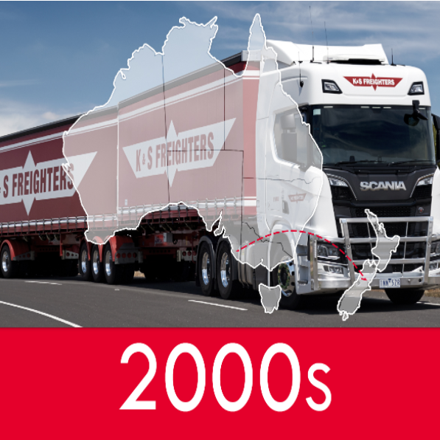

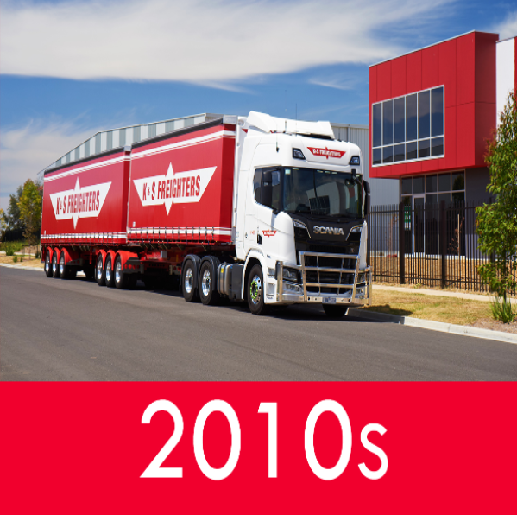
1
Background
Brief History
Formed in 1945 and kept evolving to one of Australia and New Zealand’s largest National multi-modal providers of transport and distribution services.
Key Business Objectives
road, rail and coastal sea forwarding...
multiple sub-companies
Challenges
COVID-19
Increasing needs in logistics
Higher standard

